Slide 1

Biologically plausible recurrent neural network for working memory tasks
Supervisor: Yashar Ahmadian
Author: Jasmine Cheng
Acknowledgment of Prior Work: David He

Slide 2
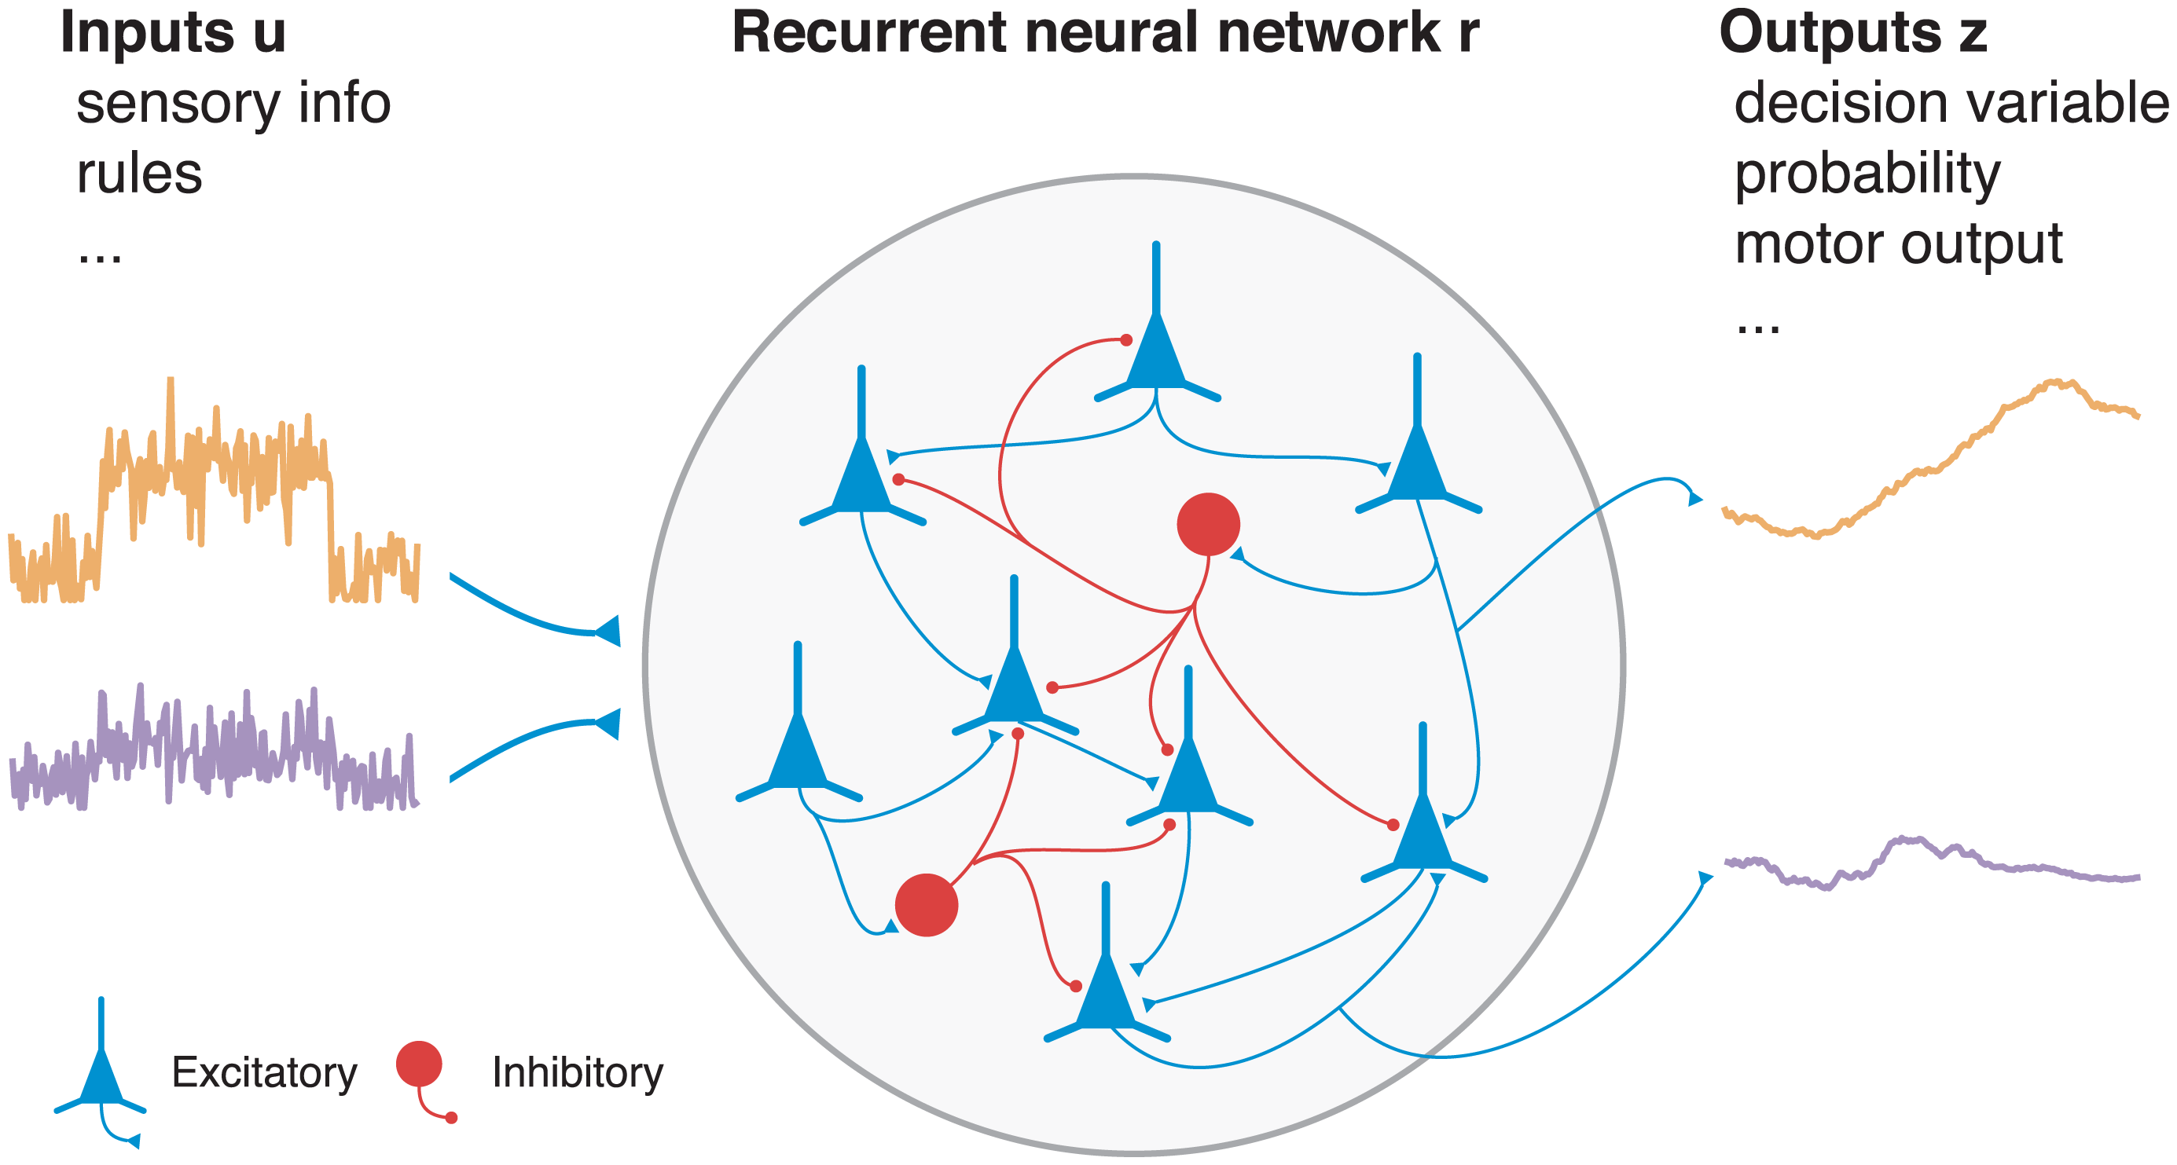



Introduction
Brain networks are highly recurrently connected
Firing rate equations
After discretization,
Vanilla RNN does not perform well in sequential tasks e.g. natural language processing , which require high working memory
Certain artificial RNNs(aRNN) have high working memory
However, these aRNNs have features that are not biologically plausible
Biological features like short term plasticity and conductance-based synaptic inputs are not incorporated in vanilla RNN
We want to see if these features help give RNN a higher computational capacity

Slide 3
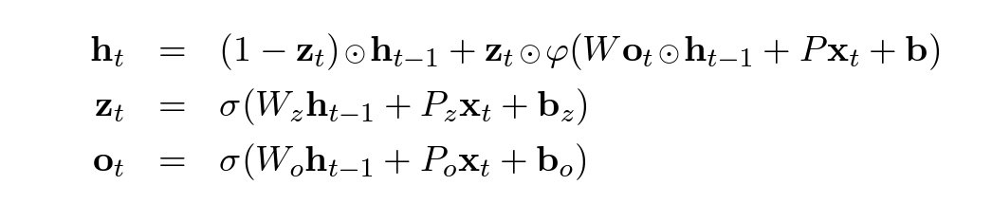
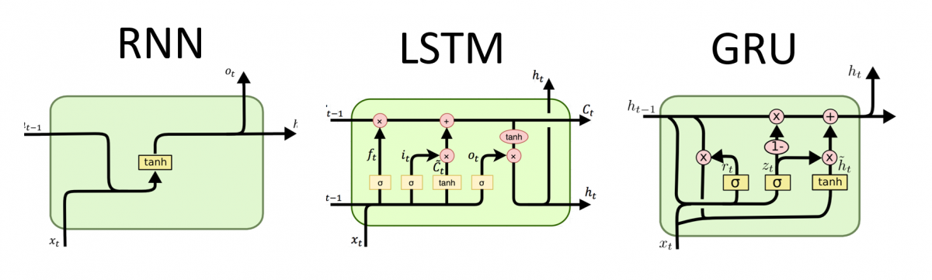
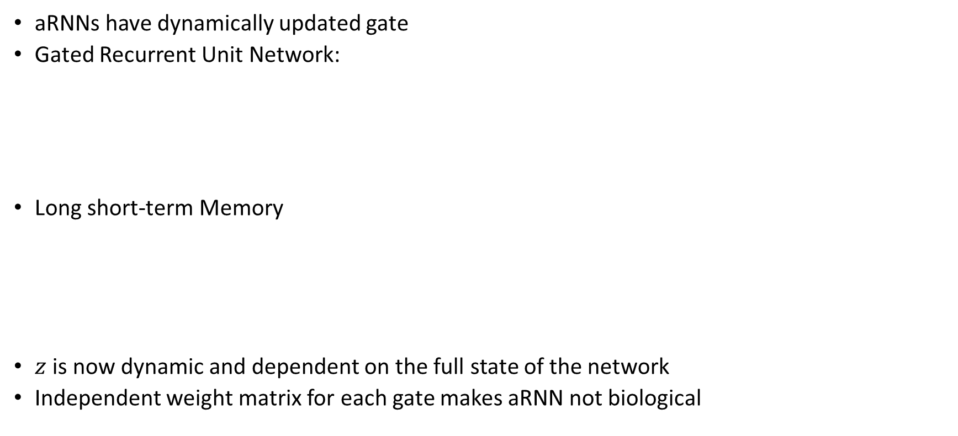
Background
aRNNs have dynamically updated gate
Gated Recurrent Unit Network:
Long short-term Memory
$z$ is now dynamic and dependent on the full state of the network
Independent weight matrix for each gate makes aRNN not biological

Slide 4
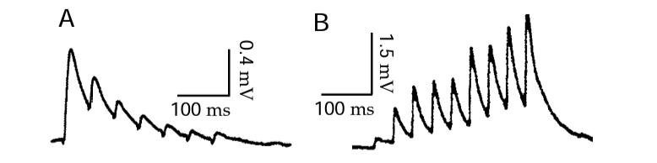
Background
Short term plasticity
Refers to the temporary variation (0.5-2 sec) in synaptic strength in response to synaptic activities, either facilitation or depression
Has been suggested as a substrate of working memory
Postsynaptic potential
Presynaptic inputs

Slide 5
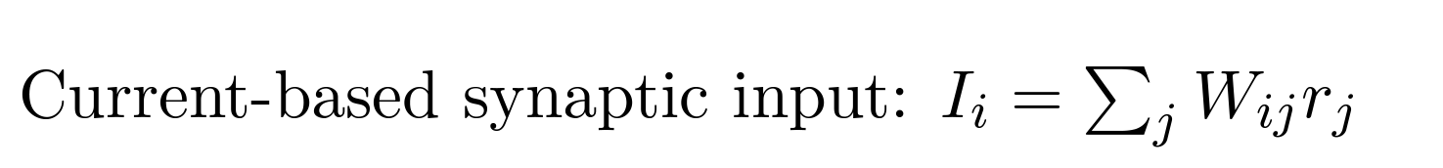
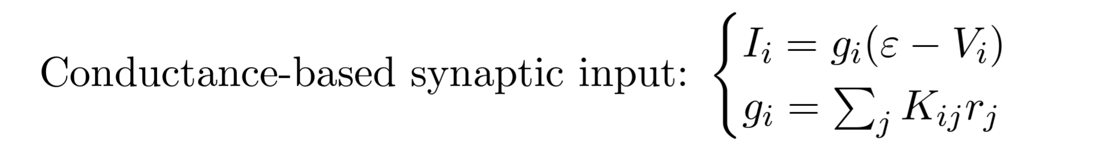
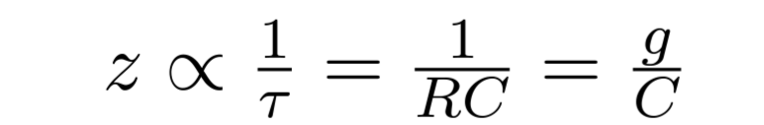

Background
Short term plasticity
Refers to the temporary variation (0.5-2 sec) in synaptic strength in response to synaptic activities, either facilitation or depression
Has been suggested as a substrate of working memory
Conductance-based synaptic inputs
Presynaptic firing directly effect synaptic conductance and hence the synaptic current
In this model, firing rate $r_{j}$ changes the current $I_{i}$ into postsynaptic cell and the time constant $z$.
Therefore, these two properties also lead to a dynamic $z$

Slide 6
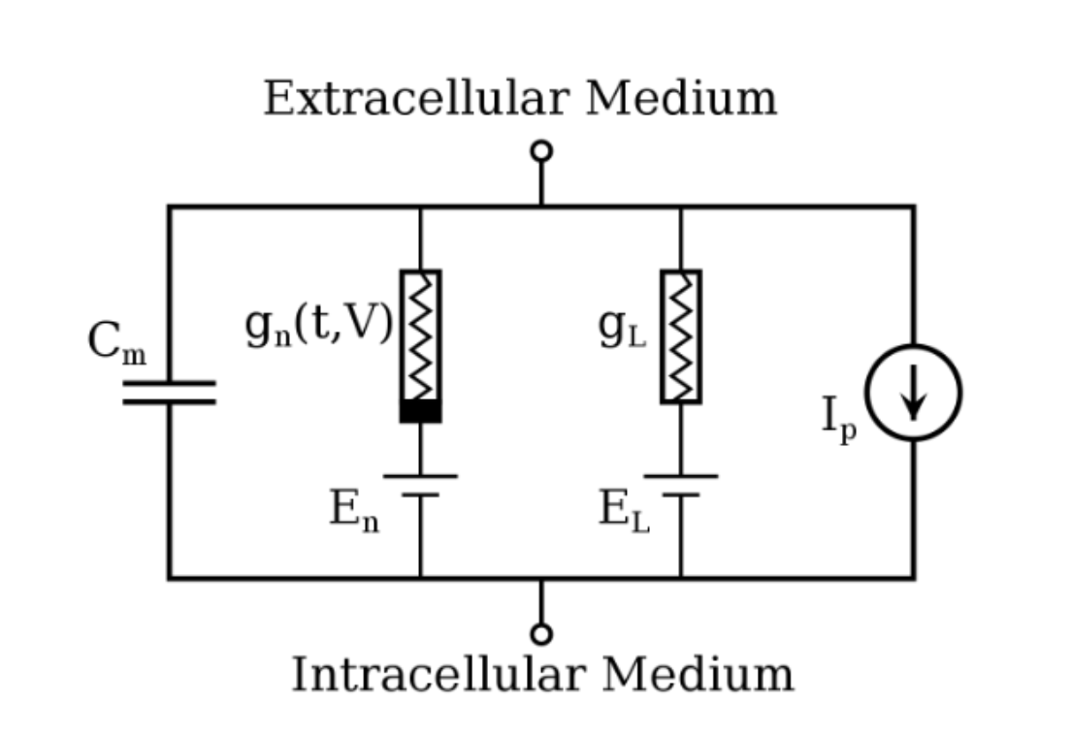
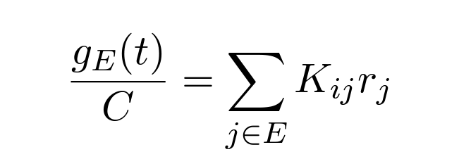
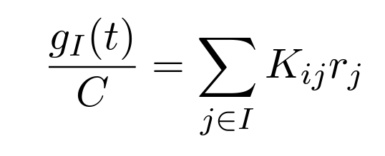
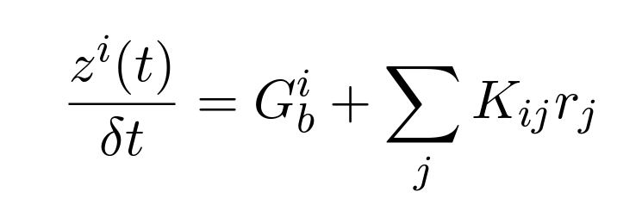
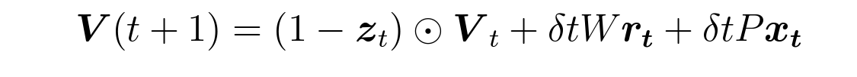
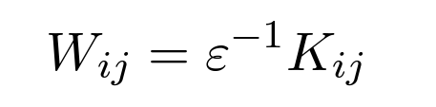
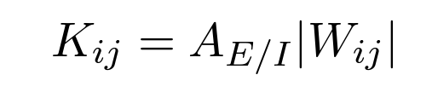

Modelling
Carrying forward the biological features,
Synaptic conductances are weighted contribution by pre-synaptic neurons,
After discretising and arranging terms,
$ε$, the reversal potential, can be either positive or negative,

Slide 7
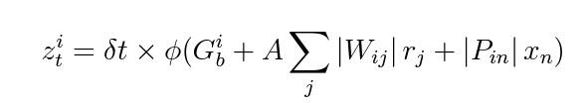
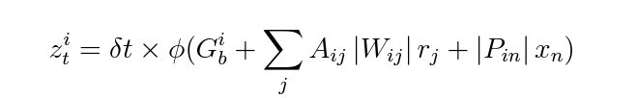
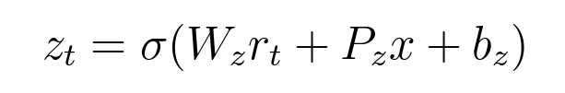
Modelling
Referencing to the voltage-based conductance model, we have proposed our bRNN model as follow:
Constant-A bRNN: the scaling factor A is a constant
Matrix-A bRNN: the scaling factor A is a square matrix depending on the presynaptic and postsynaptic neuron
Simple-GRU is a nice and simple model to represent ANN’s performance in sequential tasks

Slide 8
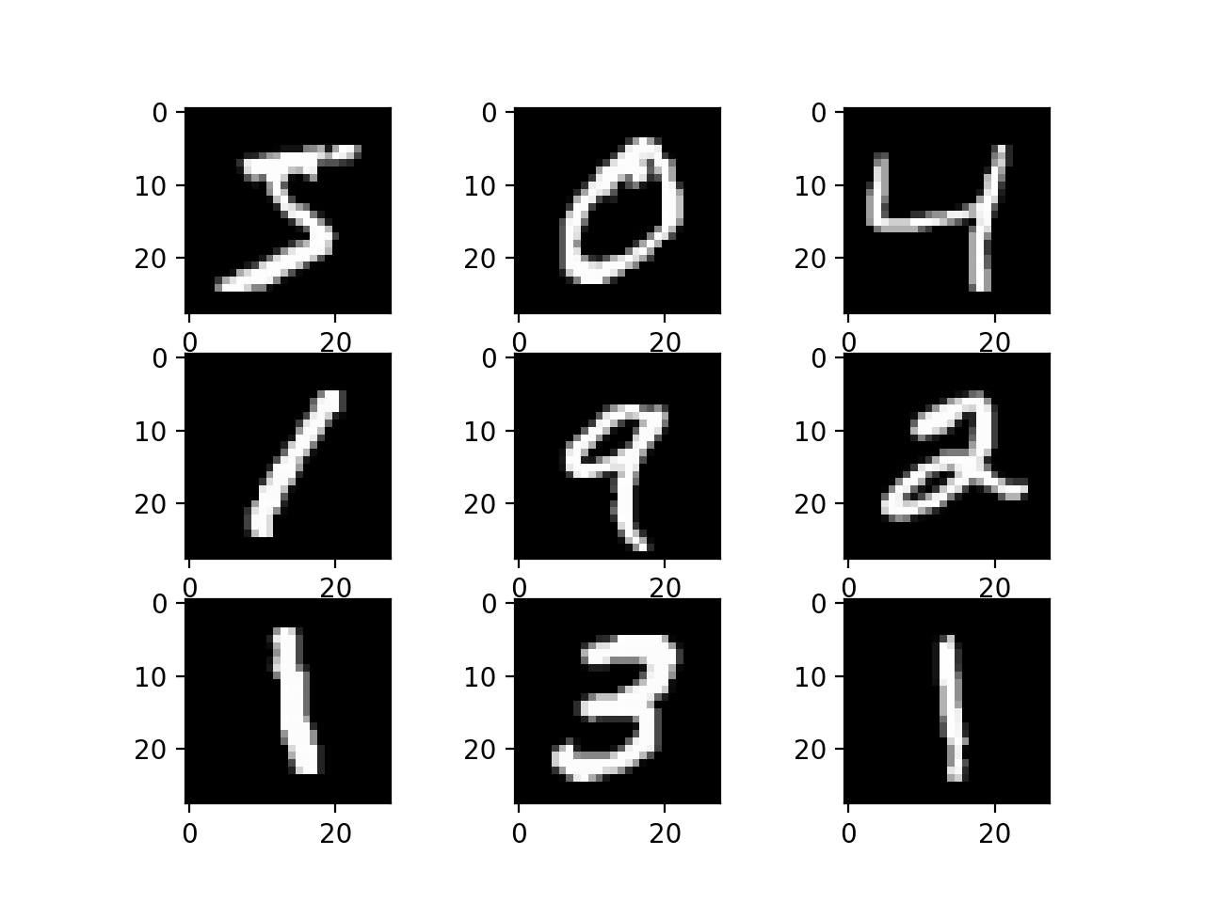
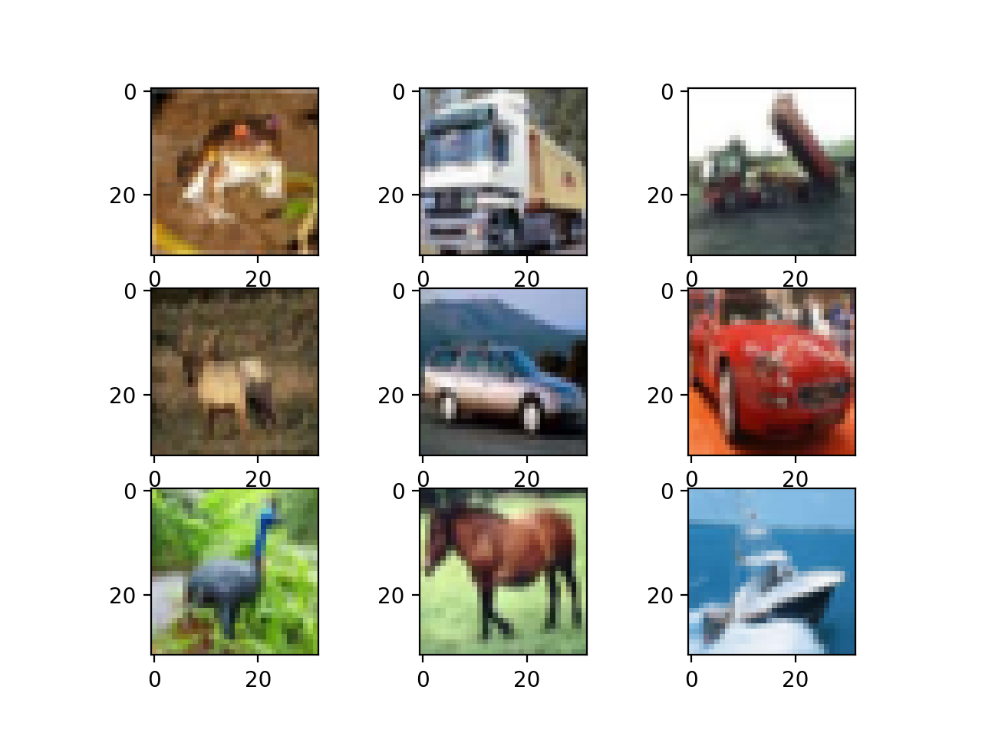
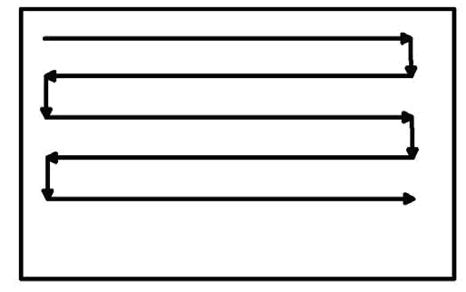
Methods
MNIST dataset
28*28 grey scale images
Size of dataset: 60000 training images and 10000 test images
the networks read one pixel at a time in scanline order
CIFAR-10 dataset
32*32 pixels and 3 colour channel
Size of dataset: 50000 training images and 10000 test images
The pixels are turned into sequential input using a ‘snake scan’

Slide 9
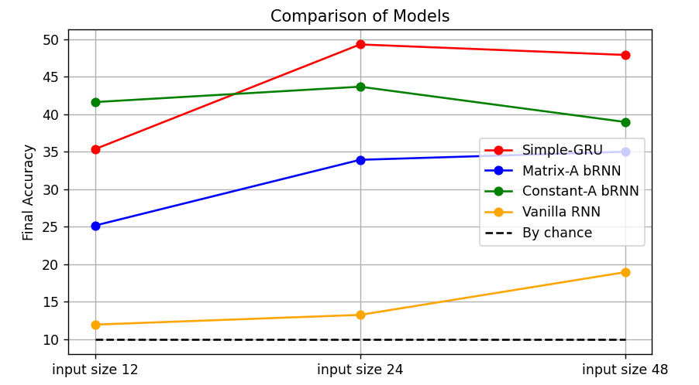
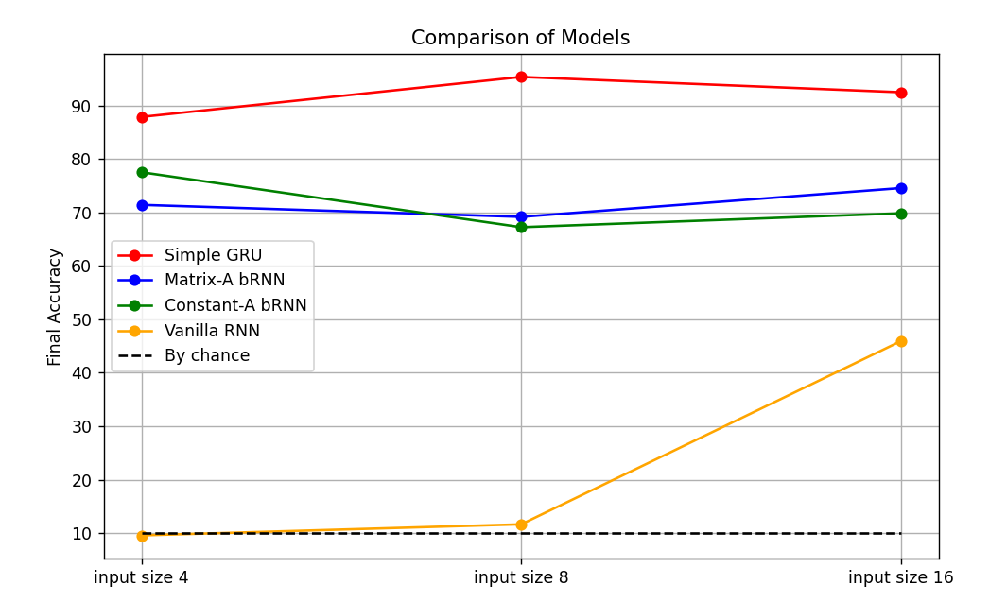
Preliminary Results
Comparison of Models using CIFAR-10 dataset
Comparison of Models using MNIST dataset
Hidden size | 24 for MNIST 100 for CIFAR
Batch size | 100
Number of layer | 1
Learning rate | Bayesian optimized
Constant-A bRNN outweighs simple GRU at low input size
Simple GRU seems to pick up features very fast, but its behaviour starts to drop quickly as well
The two conductance-based bRNNs do much better than vanilla RNN
Simple GRU model still outweighs the two conductance-based bRNN.
Matrix-A bRNN only have slight advantage over constant-A bRNN.

Slide 10

Summary and Future Plans
At this point we have proposed bRNN model that are endowed with conductance-based inputs
In the future we plan to:
By implementing short term plasticity and excitatory and inhibitory synapses, get a spectrum of model with different degree of biological features
Work on different sequential tasks and compare the models
Explore tasks that reflect behavioural flexibility and context-dependent decision making e.g. Two-armed bandit problem

